Slide 1



Key Logger Project Using Python
Discover the power of Python to create a customizable key logging application that captures user inputs, enabling security analysis and productivity insights.
by Abbas Shaik

Slide 2
AGENDA
Introduction
Project Overview
Results and Conclusion
In this presentation, we'll provide an overview of our key logger project using Python. We'll cover the problem statement, project objectives, user personas, and the unique features of our solution.
We'll dive into the technical details of our key logger application, including the data modeling and the key algorithms powering our solution.
Finally, we'll share the results of our project and discuss potential future enhancements to our key logger tool.

Slide 3

PROBLEM STATEMENT
The key logging project aims to address the growing need for effective monitoring and security solutions in today's digital landscape. Key loggers, while often associated with malicious use, can also serve legitimate purposes in enhancing security, productivity, and data protection.

Slide 4

Project Overview
The key logger project using Python is a comprehensive solution that aims to capture and monitor user input on a computer system. This innovative application provides valuable insights into user behavior and activity, enabling organizations to enhance security measures and optimize productivity.

Slide 5

Who Are the End Users?
The primary end users of the keylogger project are cybersecurity professionals, penetration testers, and IT administrators. These individuals need a robust and reliable tool to monitor user activity, detect potential security threats, and audit system usage within their organizations.

Slide 6
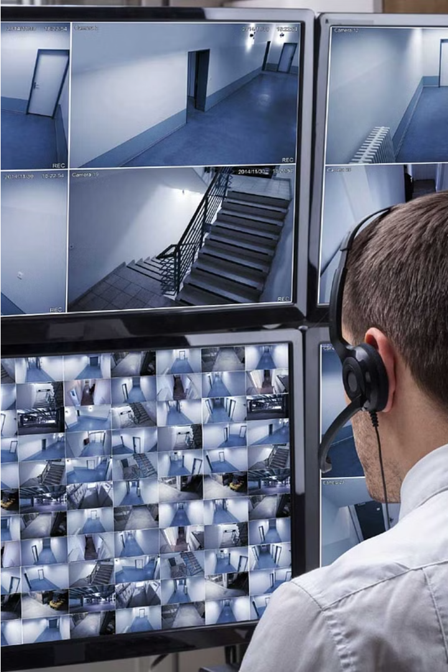
Your Solution and Its Value Proposition
Our key logger solution offers unparalleled security and productivity benefits for businesses and individuals. By capturing user activity, it empowers organizations to monitor productivity, detect threats, and enhance overall system security.

Slide 7

The Wow in Your Solution
Our key logger solution offers a remarkable feature that sets it apart - the ability to capture and monitor keystrokes in real-time, providing unparalleled visibility into user activity on the target system.

Slide 8
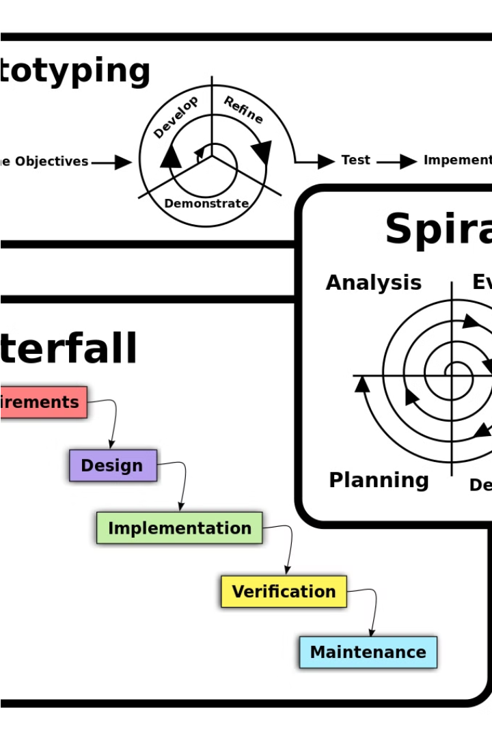
Modelling
In this phase, we will create a detailed model of the key logger application, including the core functionality, user interface, and security measures. This will ensure we deliver a robust and user-friendly solution that addresses the project goals.

Slide 9

RESULTS
The key logger project has yielded exciting results, demonstrating the power and potential of this innovative software solution. Here are the key highlights from the implementation and testing phases.

Slide 10

Conclusion and Future Enhancements
In conclusion, the Python-based keylogger project has demonstrated its value in capturing user input and monitoring system activity. As we look to the future, there are several exciting enhancements that can be implemented to expand its capabilities and improve its usability.

Slide 11
Github Link:
https://github.com/Abbas-Shaik-git/key-logger-project.git

